Slide 2

Agenda
ECG signal and arrhythmias
Literature review
Workflow
Dataset description and pre-processing
Feature extraction
Machine learning models – random forest, -----
Deep learning models
Multi-lead Branch Fusion Network (MLBF)
Attention Time Incremented- CNN (ATI-CNN)
Convolution Neural Network (CNN)
ResNet and Modified ResNet Model
Performance Summary and Conclusion

Slide 3
ECG signal and Arrhythmias
Electric pulses control timing, synchronization and pumping action of the heart
ECG signal is a graphical representation of heart pulses (voltage vs time) captured using electrodes placed on the skin
ECG can be analyzed by studying waveform components - P, Q, R, S, T
Typically, 12 leads are used to analyze an ECG - 6 limb leads & 6 chest leads
Benefits of portable ECGs:
Availability in ambulances, public places, and for home monitoring
Remote monitoring in rural areas and collaboration with experts
1 in 4 deaths in India are attributed to CVDs
4-fold increase in CVDs over the past 40 years
Low per capita availability of Cardiologists
ECG animation
* Source: who.int, nih.gov

Slide 4
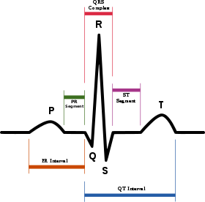
ECG signal and Arrhythmias
Arrhythmia Type | Relevant ECG components
1st degree atria ventricular block | TBD
Atrial Fibrillation
Right branch bundle block
Left Branch Bundle Block
Premature atrial contraction (PAC)
Premature ventricular contraction (PVC)
ST segment depression
ST segment elevation
Components of ECG Signal
*Normal Sinus Rhythm is the healthy heart condition

Slide 5
Literature Review
MLBF-Net: A Multi-Lead-Branch Fusion Network for Multi-Class Arrhythmia Classification Using 12-Lead ECG https://www.ncbi.nlm.nih.gov/pmc/articles/PMC7963211/
Architecture, Performance
Multi-class Arrhythmia detection from 12-lead varied-length ECG using Attention-based Time-Incremental Convolutional Neural Network https://www.sciencedirect.com/science/article/pii/S1566253518307632
Architecture, Performance
Pre-trained deep neural network models for ECG automatic abnormality detection https://zenodo.org/record/3765717#.YN snugz bUY
Architecture, Performance
Automatic diagnosis of the 12-lead ECG using a deep neural network https://www.nature.com/articles/s41467-020-15432-4
Architecture, performance
Cardiologist level arrhythmia detection and classification in ambulatory electrocardiograms using a deep neural network Pranav Rajpukar,Awni Y.Hannun https://stanfordmlgroup.github.io/projects/ecg2/
Architecture, performance

Slide 6
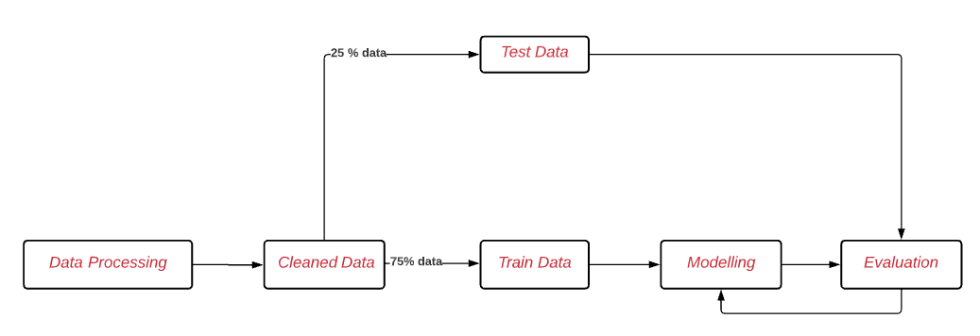
Workflow
Flowchart:
EDA and data pre-processing
ML: Feature extraction, modeling, performance evaluation
DL: modeling, performance evaluation
Report <<>>

Slide 7
Dataset description
Data Source: China Physiological Signal Challenge 2018
Data Description
Total recordings: 6877
Recording duration: 6 seconds to 60 seconds
Labels: 9 classes corresponding to 8 types of arrhythmias and 1 normal rhythm
Data Selected for 6-lead portable ECG device
Sampling frequency: 500 Hz
Leads: II, V1, V2, V3, V5, V6
Training set corresponding to 5682 recordings
Labels: 7 classes (Atrial Fibrillation and Left Branch Bundle Block dropped
Arrhythmia Type | Recordings
Normal Sinus Rhythm | 918
1st degree atria ventricular block | 722
Right branch bundle block | 1857
Premature atrial contraction | 617
Premature ventricular contraction | 700
ST segment depression | 869
ST segment elevation | 220

Slide 8
Feature extraction
Feature extraction

Slide 9
ML Pipeline
Data Pre-processing
Feature extraction
Feature
scaling
Model
training
Model validation
Features extracted for 6-leads and merged together
Scaling using standard scalar (MinMax scalar accuracy was much lower)
Train-test split at 80:20
Multi-label classification done using following models:
K-Nearest Neighbors (KNN)
Decision Tree
Random Forest
Gradient Boosting Classifier

Slide 10
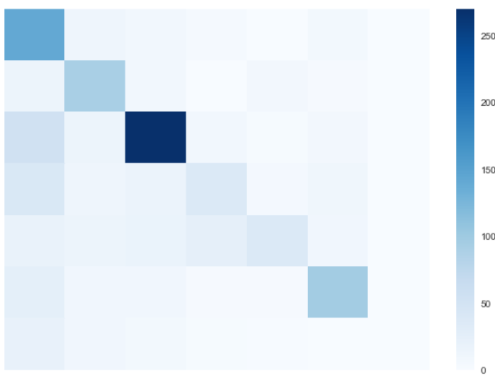
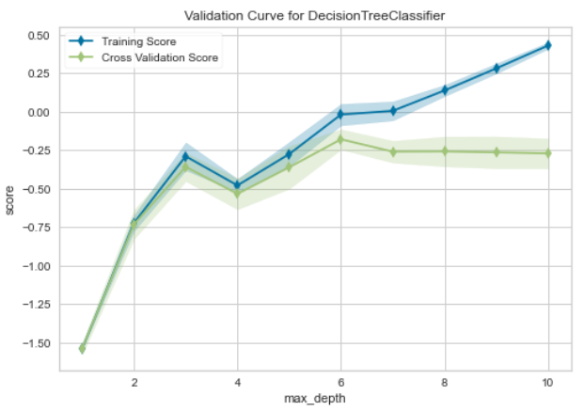
Decision Tree
Base Model
Hyperparameter Tuning
Hyperparameter Tuning
(fully-grown trees using sklearn)
(pruned to reduce max-depth of 4)
(multiple parameters optimized using Grid Search)
Train accuracy: 98.7%
Test accuracy: 53.2%
Precision: 0.54
Recall: 0.53
f1 score: 0.53
Train accuracy: 56.0%
Test accuracy: 49.8%
Precision: 0.49
Recall: 0.50
f1 score: 0.47
Train accuracy: 58.5%
Test accuracy: 58.0%
Precision: 0.58
Recall: 0.58
f1 score: 0.57
Over-fitting
Lower accuracy
Final accuracy
Note: (1) Features extracted for 6 leads were use to train Decision Tree model
(2) Feature scaling was done using StandardScalar (accuracy for MinMaxScalar was lower)
(3) Train test ratio was 80:20

Slide 11
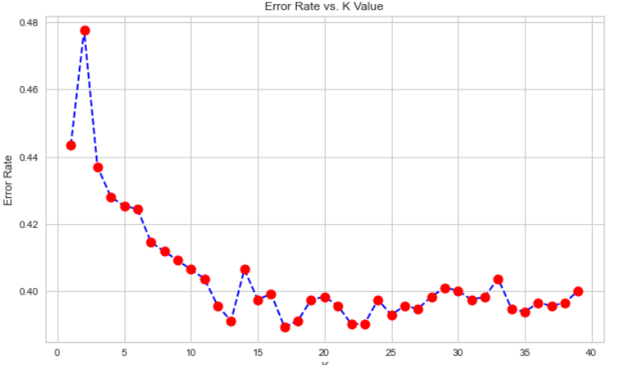
KNN Model
KNN is a classification algorithm that predicts based on majority label of “k” closest points
Choosing a k affects the predicted values
Base Model (k=1)
Base Model (k=1)
Train accuracy: 98.7%
Test accuracy: 26.9%
Precision: 0.54
Recall: 0.53
f1 score: 0.53
Train accuracy: 65.7%
Test accuracy: 53.2%
Precision: 0.54
Recall: 0.53
f1 score: 0.53

Slide 12
Other Models
Random Forest
Train accuracy: 98.6% 67.8%
Test accuracy: 69.3% 66.4%
Precision: 0.70 0.62
Recall: 0.70 0.62
f1 score: 0.69 0.59
Hyperparameters tuned using validation curve:
max depth (5)
n_estimators (50)
Gradient Boosting
Train accuracy: 43.0% 67.8%
Test accuracy: 39.9% 62.4%
Precision: 0.70 0.62
Recall: 0.70 0.62
f1 score: 0.59
Hyperparameters tuned using validation curve:
max depth (2)
n_estimators (30)
More work to be done on feature extraction to increase model accuracy

Slide 13
Github Link
https://github.com/Anupriya-Sri/ECG-monitoring-and-decision-support-system
MLBF is best performing model… diverse features identify.. Higher accuracy

Slide 14
Future Scope
Additional features to increase (frequency features)
DL models to be trained using pre-processed features
Increasing dataset and real-life data set
Expansion of 6 lead models to 12-leads
Deployment to hardware device

Slide 15
Back-up

Slide 16
12-leads in ECG recording
<<from wikipedia>>

